Slide 1
CS-2001 Data Structures
Week 2 | Lecture 4-7

Slide 2
Topics
Recursion, it's types, issues.
Backtracking

Slide 3
Recursive Approach
In a recursive approach, a problem is broken into smaller sub-problems repeatedly. Eventually a rollback is performed to combine solutions to sub-problems to create an overall solution to the main problem
Recursive algorithms are common

Slide 4
Recursion
A function which calls itself is called recursive
A recursive method solves a problem by calling a copy of itself to work on a smaller problem
This recursion step can result in many more such recursive calls

Slide 5
Format of a Recursive Function
if(test for base case)
return (some base case value)
else
do some work return (a recursive call)

Slide 6
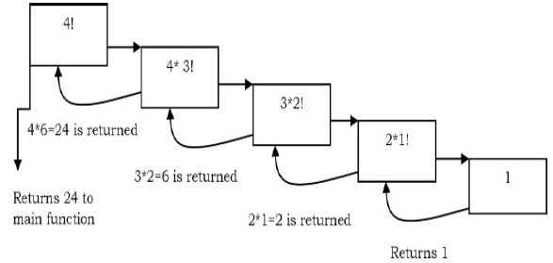
Example

Slide 7
Recursion vs Iteration
Which approach is better?
Depends on what the problem is!
In theory, all iterative algorithms can be implemented using recursion and vice versa

Slide 8
Recursion
Terminates when a base case is reached
Each recursive call requires extra memory
If we get infinite recursion, the program may run out of memory and result in stack overflow
Solutions to some problems are easier to formulate recursively!!!

Slide 9
Iteration
Terminates when a condition becomes false
Each iteration does not require extra space
An infinite loop could loop forever since there is no extra memory being created
Iterative solutions to a problem may not always be as obvious as a recursive solution

Slide 10
Discussion
Generally, iterative solutions are more efficient than recursive solutions [due to the overhead of function calls]
Some problems are best suited for recursive approach
A recursive algorithm can be implemented without using a recursive call
How??
Is it worth it???

Slide 11
Types of Recursion
Direct
Indirect
Tail Recursion
Non Tail Recursion

Slide 12
Types of Recursion
Direct Recursion: A function is called direct recursive if it calls the same function again.
Indirect Recursion: A function(fun1) is called indirect recursive if it calls another function(fun2 ) and then fun2 calls fun1 directly or indirectly.

Slide 13
Types of Recursion
Tail Recursion: A recursive function is said to be tail recursive if the recursive call is the last thing done by the function. There is no need to keep the record of the previous state.
Non-Tail Recursion: A recursive function is said to be non-tail recursive. if the recursive call is not the last thing done by the function. There is something left to evaluate.

Slide 14
Backtracking
Backtracking is a technique used to solve problems with a large search space, by systematically trying and eliminating possibilities.
A standard example of backtracking would be going through a maze.
At some point, you might have two options of which direction to go:

Slide 15
Backtracking
The neat thing about coding up backtracking is that it can be done recursively, without having to do all the bookkeeping at once.
Instead, the stack of recursive calls does most of the bookkeeping
(i.e., keeps track of which locations we’ve tried so far.)

Slide 16
Backtracking Maze Problem
One strategy would be to try going through position (0,0 )of the maze.
If you get stuck before you find your way out, then you "backtrack" to the position where you find any other solution.
Clearly, at a single positon you could have even more than 2 choices.
The backtracking strategy says to try each choice, one after the other,
if you ever get stuck, "backtrack" to the point where a you find the next choice.
If you try all choices and never found a way out, then there is no solution to the maze.

Slide 17
Backtracking Maze Problem
Dealing with the maze:
From your start point, you will iterate through each possible starting move.
From there, you recursively move forward.
If you ever get stuck, the recursion takes you back to where you were, and you try the next possible move.
Make sure you don't try too many possibilities,
Mark which locations in the maze have been visited already so that no location in the maze gets visited twice.
If a place has already been visited, there is no point in trying to reach the end of the maze from there again.

Slide 18
Backtracking (animation)
dead end
?
dead end
dead end
?
start
?
?
dead end
dead end
?
success!

